Slide 1
Problem Statement No.1 – Research Agent
CAPSTONE PROJECT
Presented By:
Student Name- Rajesh Kumar Baral College Name-· United School of Business Management, Bhubaneswar Department- MCA AICTE Internship Student Registration ID : STU644249793fe531682065785

Slide 2
OUTLINE
Problem Statement
Proposed System/Solution
System Development Approach
Algorithm & Deployment
Result (Output Image)
Conclusion
Future Scope
References

Slide 3
Problem Statement
The challenge is to develop an AI system, called a Research Agent, designed to assist with academic and scientific research tasks.
This agent must be capable of autonomously:
Searching literature
Summarizing research papers
Organizing references
It should comprehend research questions using Natural Language Processing (NLP) to retrieve and filter relevant information.
The agent should be intelligent enough to:
Generate structured reports
Suggest possible hypotheses
Draft sections of research papers with academic tone
The key problem it addresses is the high time and cognitive load involved in repetitive research processes such as:
Citation formatting
Metadata extraction
Keyword filtering
It also tackles the barrier to accessibility, especially for novice researchers lacking experience in data collection and paper management.
The ultimate goal is to improve efficiency, accuracy, and creative productivity in both academic and industrial R&D environments.

Slide 4
Proposed Solution
The Research Agent will include the following core modules:
Autonomous Literature Search: Using NLP to interpret queries and scan academic databases.
Summarization Engine: Generate concise and structured summaries using extractive and abstractive techniques.
Reference Manager: Automatically extract, classify, and format citations.
Query Understanding: Detect research intent and context.
Report Generator: Compile findings into structured academic sections.
Hypothesis Engine: Suggest plausible directions based on existing literature.
The system aims to relieve researchers from redundant tasks, allowing more time for hypothesis validation and experimentation.

Slide 5
System Approach
IBM Cloud Lite Services – for hosting and scaling the application.
IBM Granite (LLM) – for powering the NLP modules and text generation components.

Slide 6
Algorithm & Deployment
NLP algorithms:
Named Entity Recognition (NER)
Topic Modeling (e.g., LDA)
Text Summarization (BART / T5)
Semantic Search (using embedding models like SBERT)
Model fine-tuning:
IBM Granite can be fine-tuned on a dataset of academic articles (e.g., arXiv, PubMed).
Deployment strategy:
Cloud-based API
Docker containers for portability
Integration with online academic repositories
Validation & Testing:
Performance can be measured using ROUGE scores (for summarization)
Precision/recall for relevance in literature retrieval

Slide 7
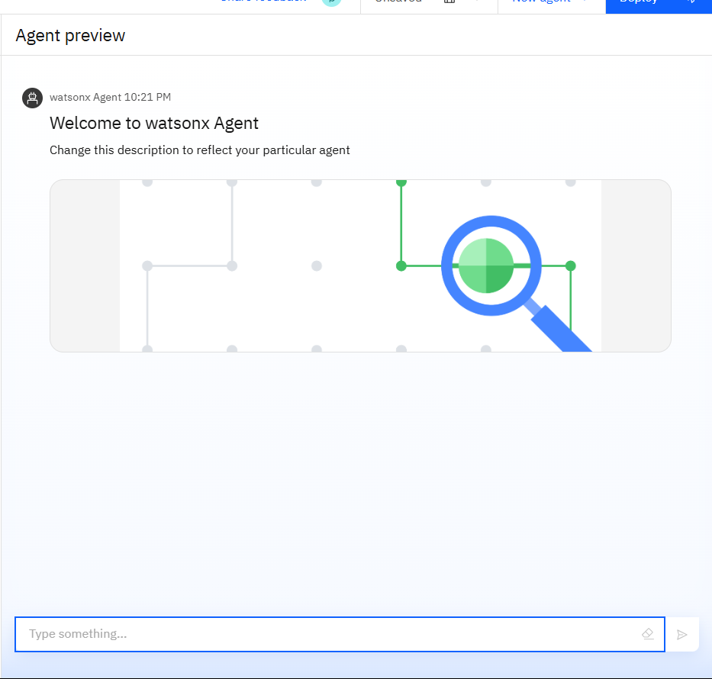
Result

Slide 8
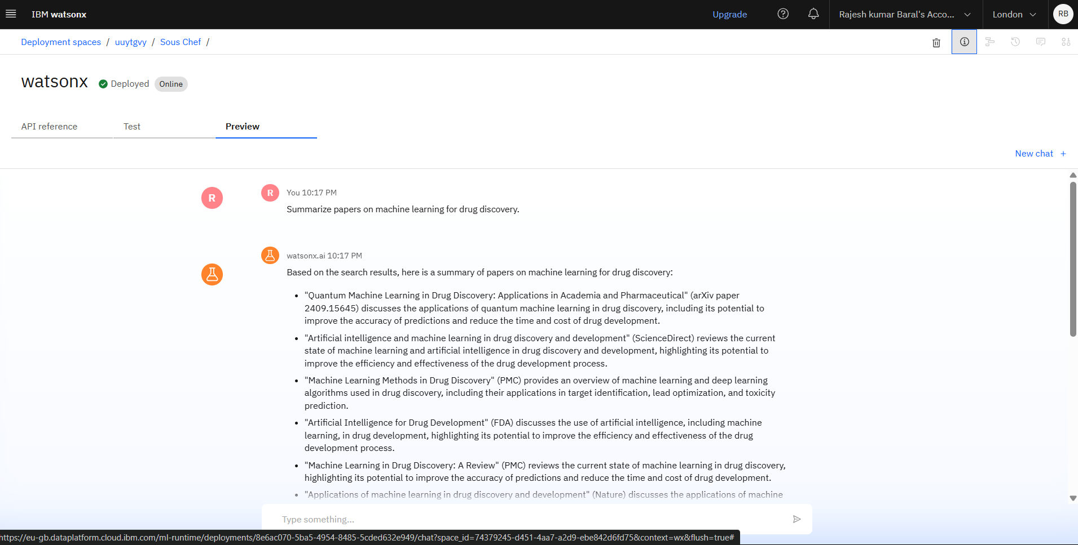
results

Slide 9
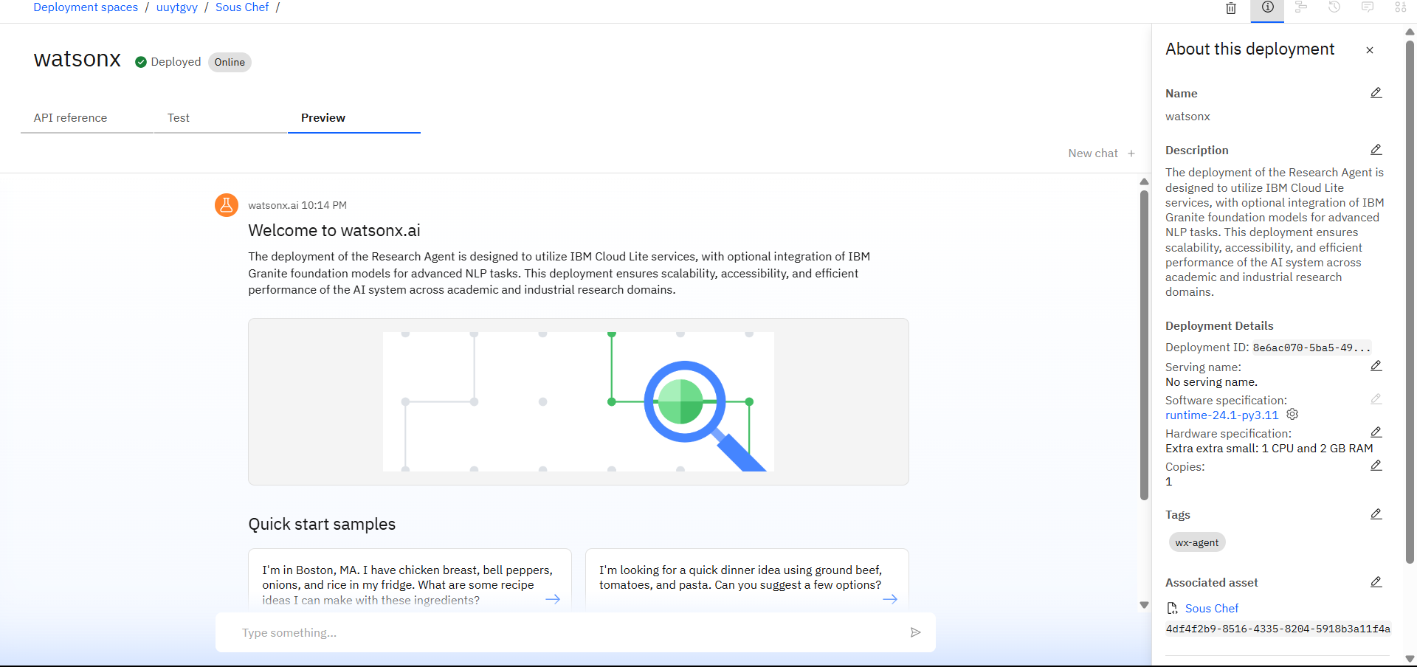
results

Slide 10
Conclusion
The project successfully addresses the time inefficiency and cognitive overload of academic research.
The Research Agent has the potential to become an indispensable assistant for students, researchers, and institutions.
It can significantly increase research output while maintaining quality by eliminating redundant manual tasks.
Encourages democratization of research, giving beginners and non-native speakers equal access to information.

Slide 11
Future scope
Integration with platforms like Google Scholar, Scopus, IEEE, and PubMed.
Multilingual support for global accessibility.
Collaboration features for teams (real-time shared workspace).
Personalized learning and reading recommendations.
Integration with citation software like Zotero or EndNote.

Slide 12
References
Internal source materials describing Research Agent functionalities.
IBM Cloud documentation.
IBM Granite and Watson NLP APIs documentation.
Academic resources (not explicitly cited in the original source).

Slide 13
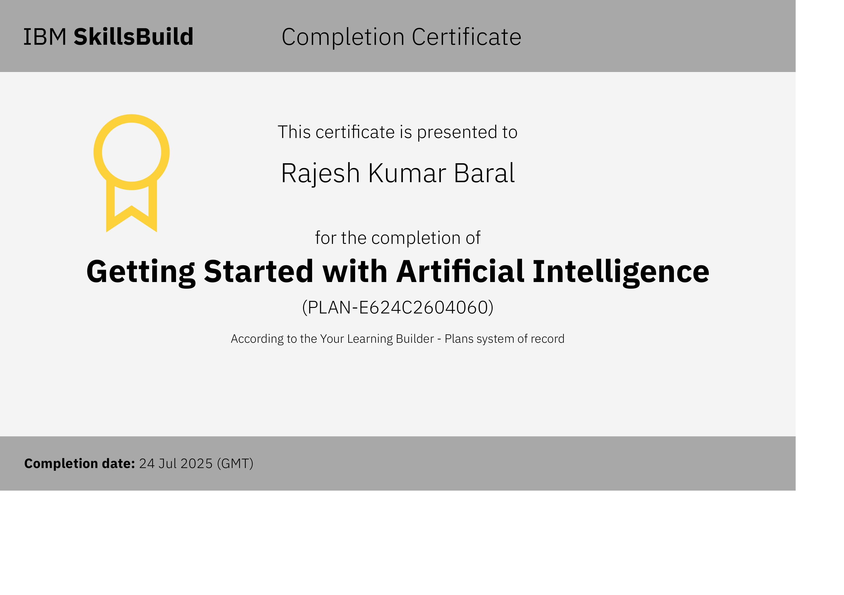
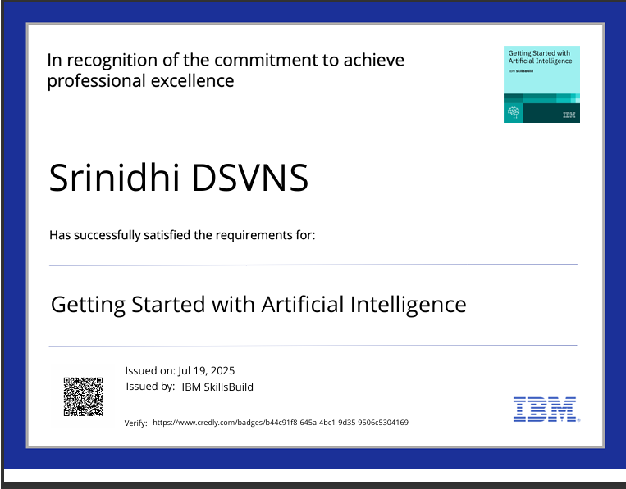
IBM Certifications

Slide 14
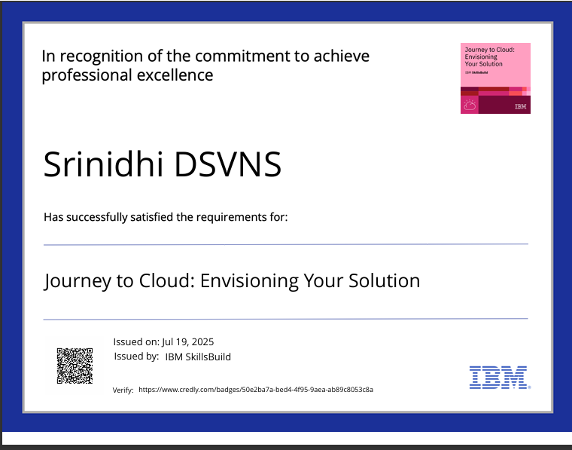
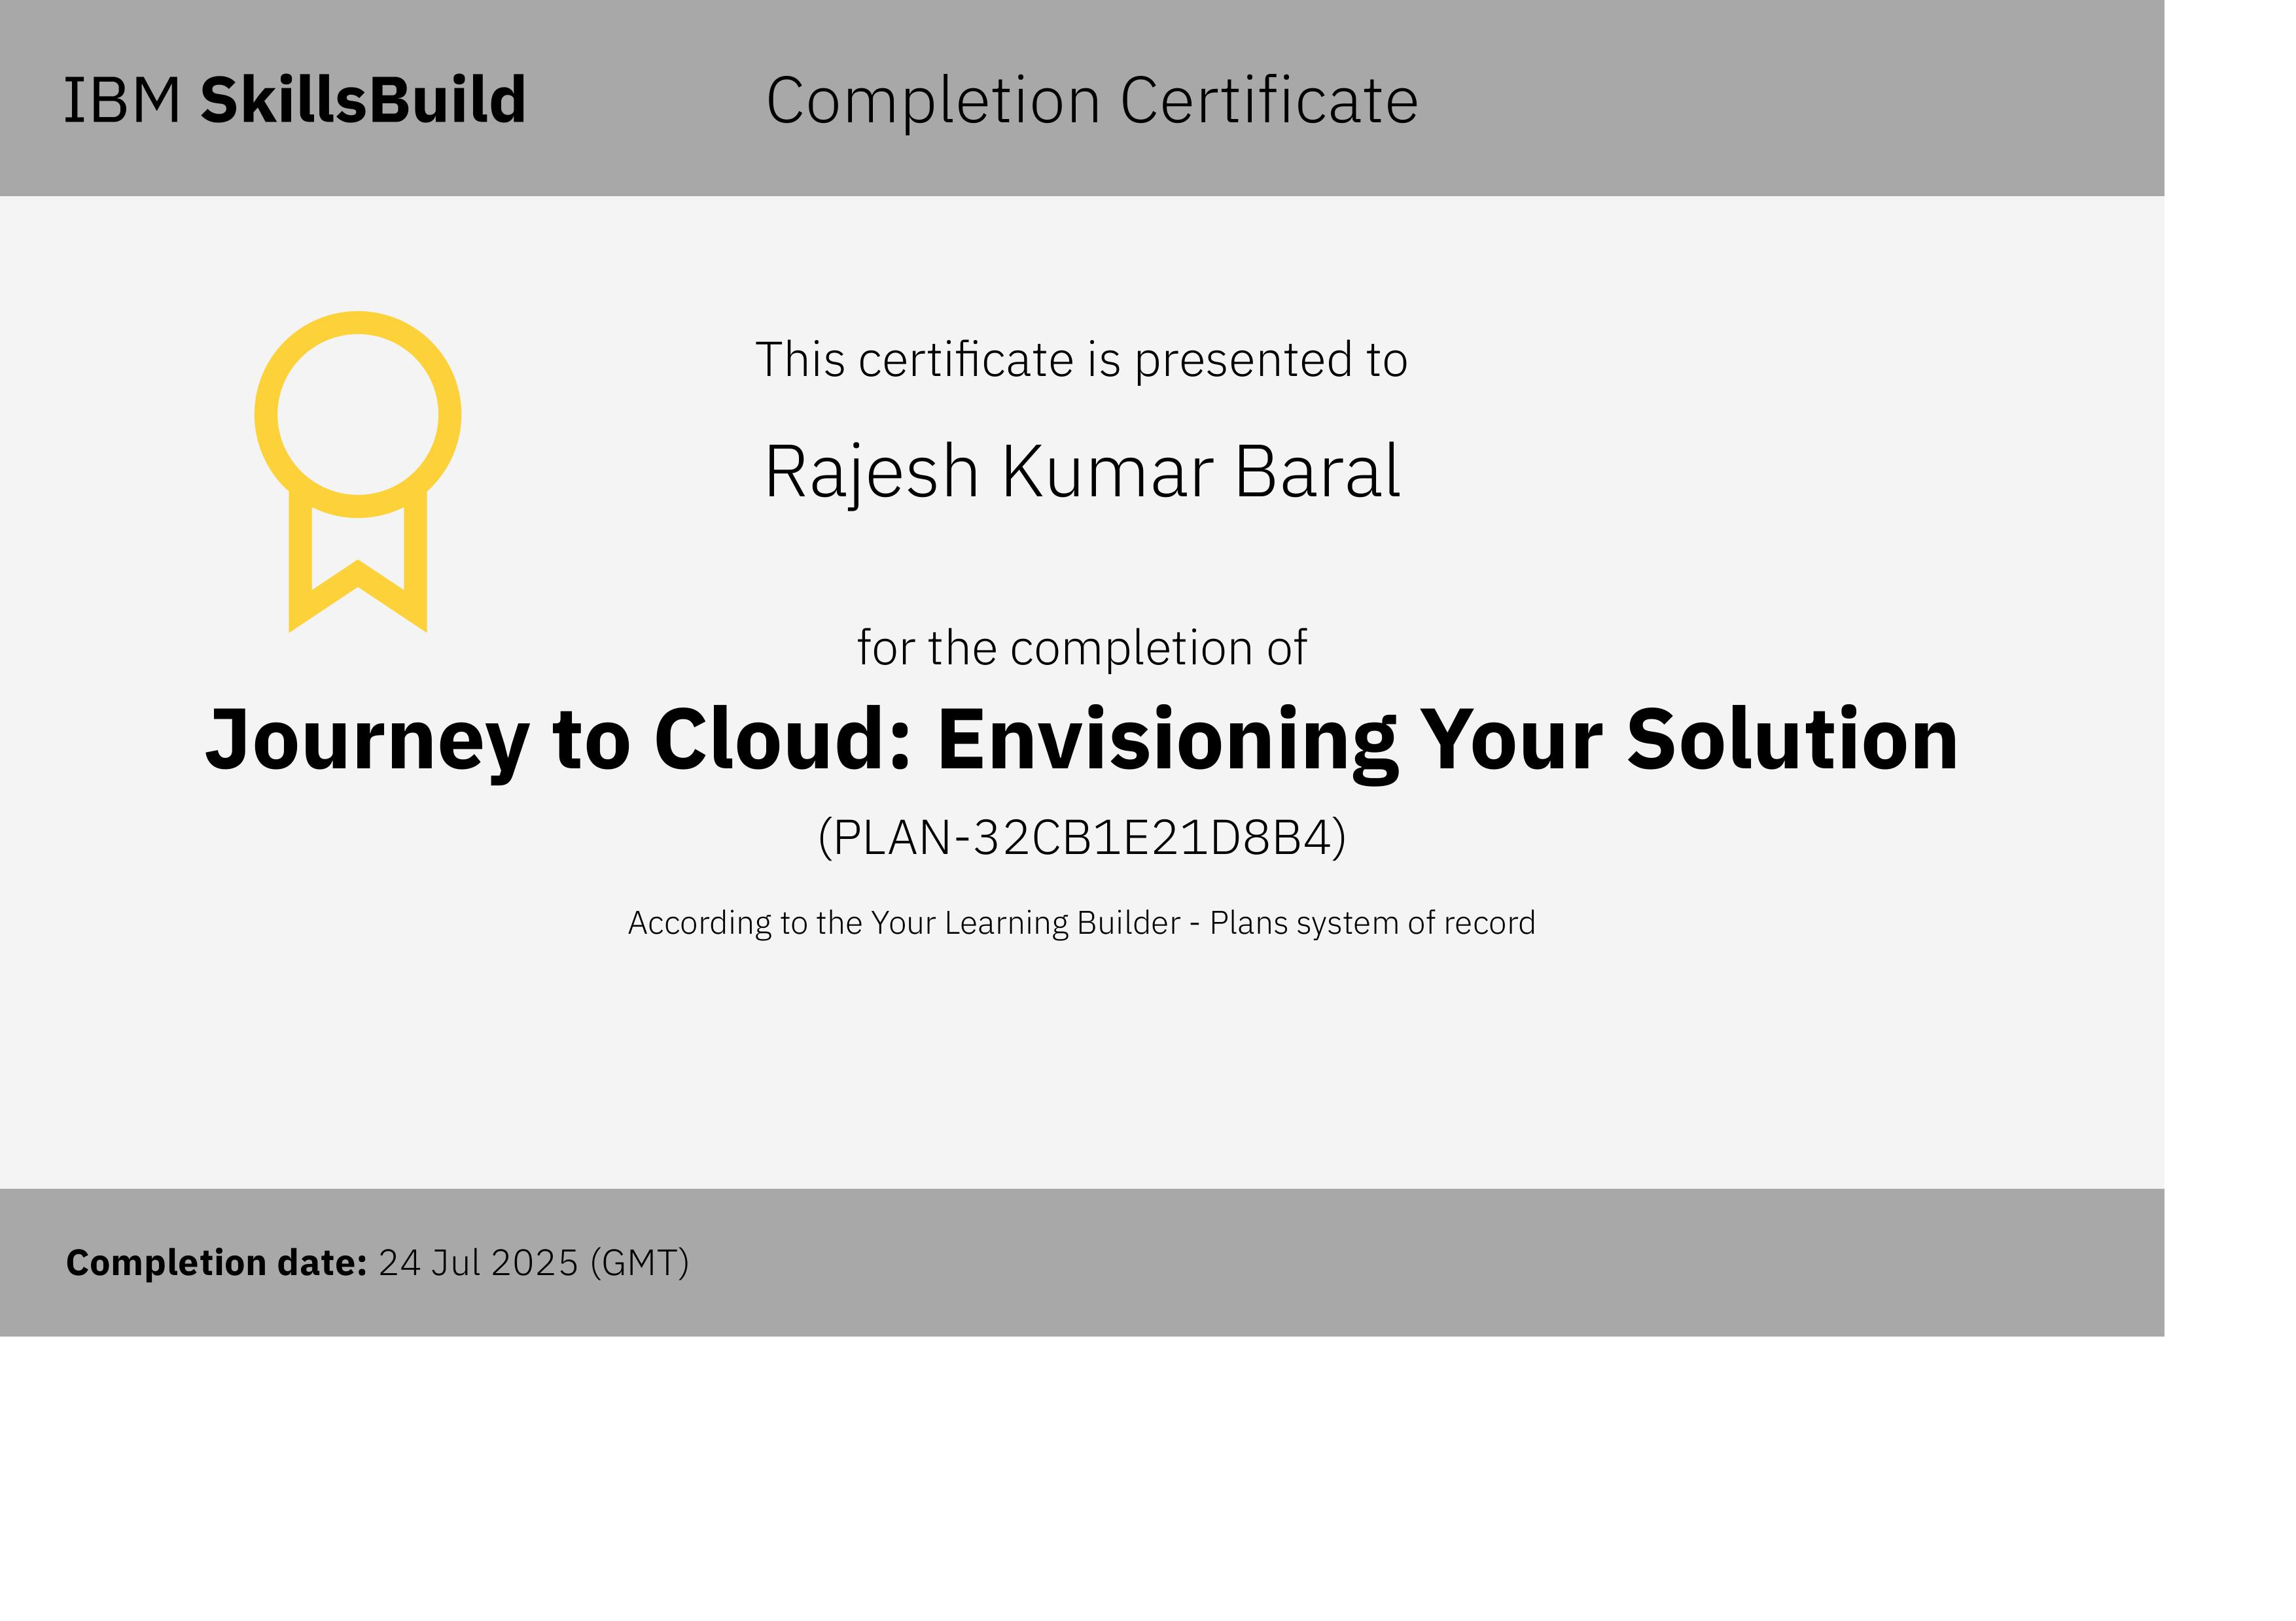
IBM Certifications

Slide 15
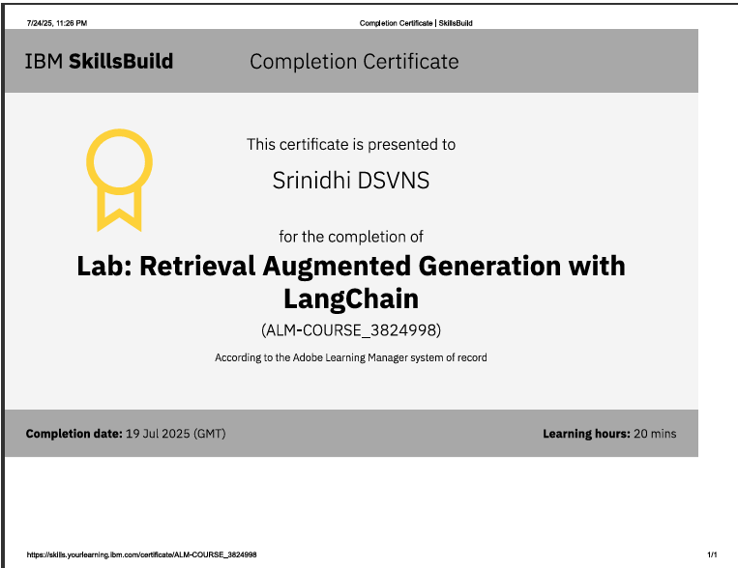
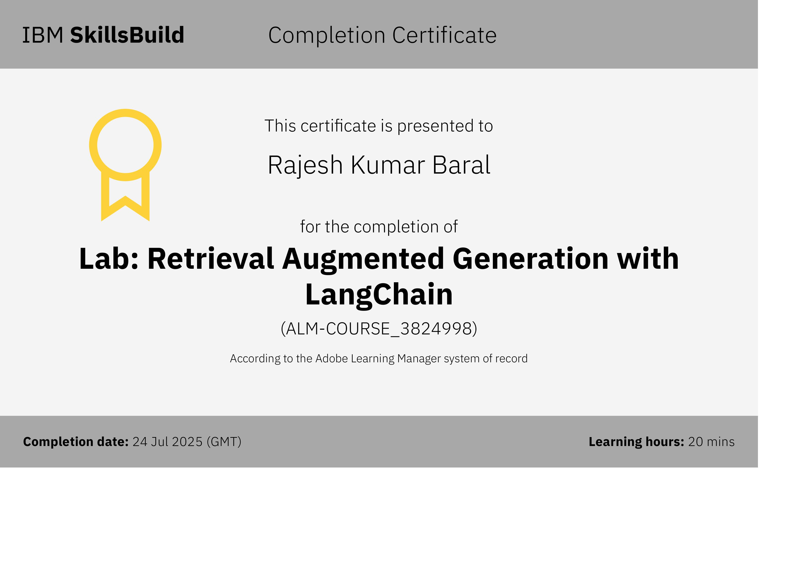
IBM Certifications

Slide 16
THANK YOU

